Slide 1
Lecture 10
INCEPTION TO
ELABORATION

Slide 2
Agenda
Define the elaboration step.

Slide 3
Elaboration
The majority of requirements are discovered and stabilized
The major risks are mitigated or retired
The core architectural elements are implemented and proven

Slide 4
What is Inception Phase
may last only one week
The artifacts created should be brief and incomplete
It is not the requirements phase of the project, but a short step to determine basic feasibility, risk, and scope, and decide if the project is worth more serious investigation, which occurs in elaboration

Slide 5
Activities and Artifacts in inception
a short requirements workshop
most actors, goals, and use cases named
most use cases written in brief format; 10-20% of the use cases are written in fully dressed detail to improve understanding of the scope and complexity
most influential and risky quality requirements identified
version one of the Vision and Supplementary Specification written
Risk list

Slide 6
Contd..
technical proof-of-concept prototypes and other investigations to explore the technical feasibility of special requirements
user interface-oriented prototypes to clarify the vision of functional requirements
recommendations on what components to buy/build/reuse, to be refined in elaboration
Candidate Tool List

Slide 7
Elaboration
the core architecture, clarifies most requirements, and tackles the high-risk issues
Elaboration often consists of between two and four iterations; each iteration is recommended to be between two and six weeks, unless the team size is massive
During this phase, one is not creating throw-away prototypes; rather, the code and design are production-quality portions of the final system.

Slide 8
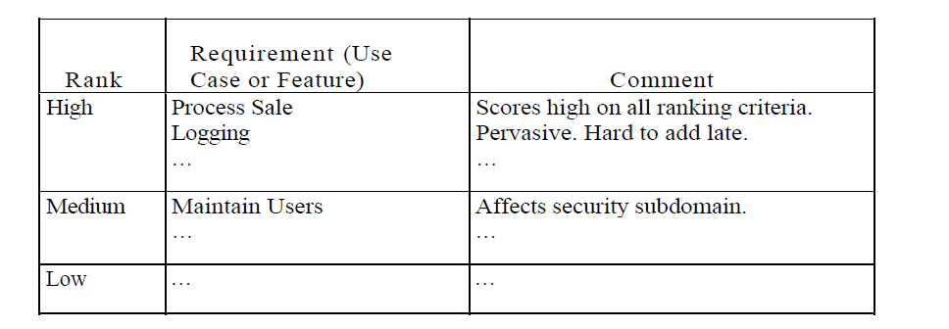
Fuzzy Grouping of requirements

Slide 9
Plans
Iteration Plan
Change Request
Software Development Plan.

Slide 10
What Artifacts May Start in Elaboration?
Domain Model
This is a visualization of the domain concepts; it is similar to a static information model of the domain entities.
Design Model
This is the set of diagrams that describes the logical design.This includes software class diagrams, object interaction diagrams, package diagrams, and so forth.

Slide 11
Contd..
Software Architecture Document
A learning aid that summarizes the key architectural issues and their resolution in the design. It is a summary of the outstanding design ideas and their motivation in the system.
Data Model
This includes the database schemas, and the mapping strategies between object and non-object representations.

Slide 12
Test Model
A description of what will be tested, and how.
Implementation Model
This is the actual implementation — the source code, executables, database, and so on.
Use-Case Storyboards, UI Prototypes
A description of the user interface, paths of navigation, usability models, and so forth.

Slide 13
References
Chapter 8 Applying UML and Patterns: An Introduction to Object-Oriented Analysis and Design and Iterative Development

